Slide 1

Widgets in Python

Slide 2

Objectives
Widgets
Discuss widgets

Slide 3
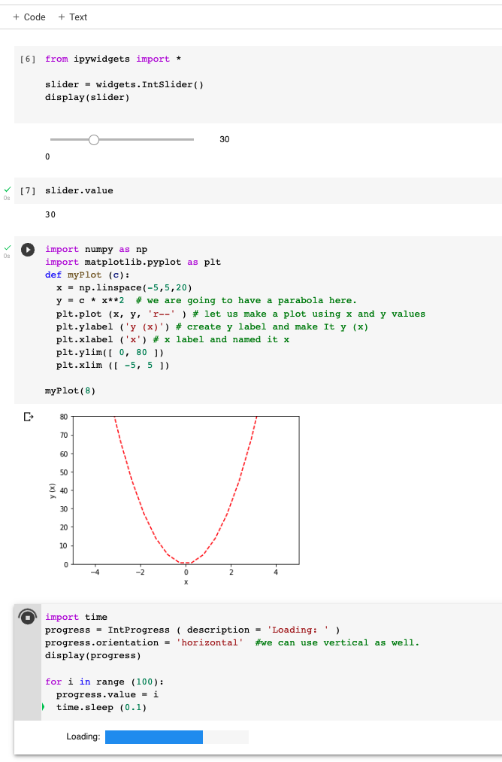
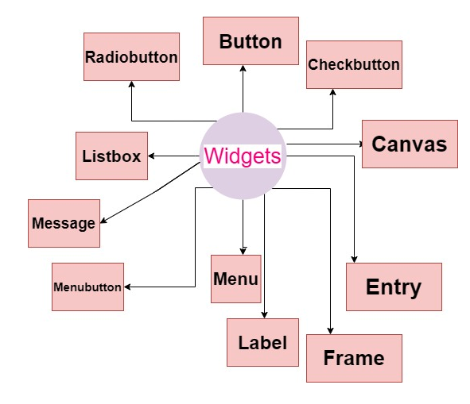
Widgets
What are widgets?
Notes:
Image from: https://www.studytonight.com/tkinter/python-tkinter-widgets

Slide 4
Demo
Demo

